Slide 1
Revature Books
A Continuous Learning Case Study
By Trent Wright

Slide 2
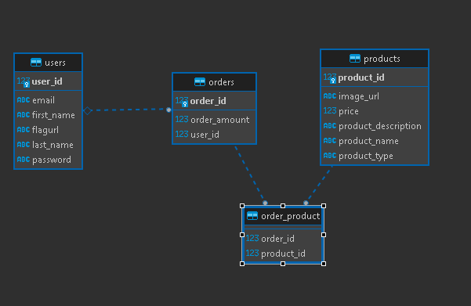
ERD

Slide 3
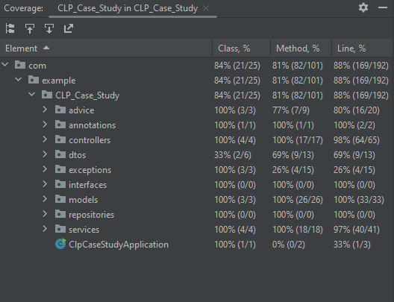
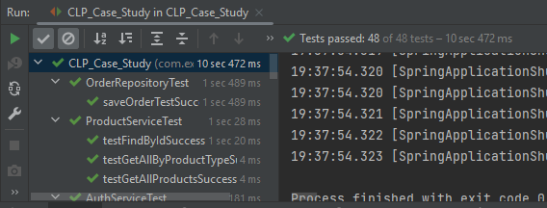
Unit
Testing

Slide 4
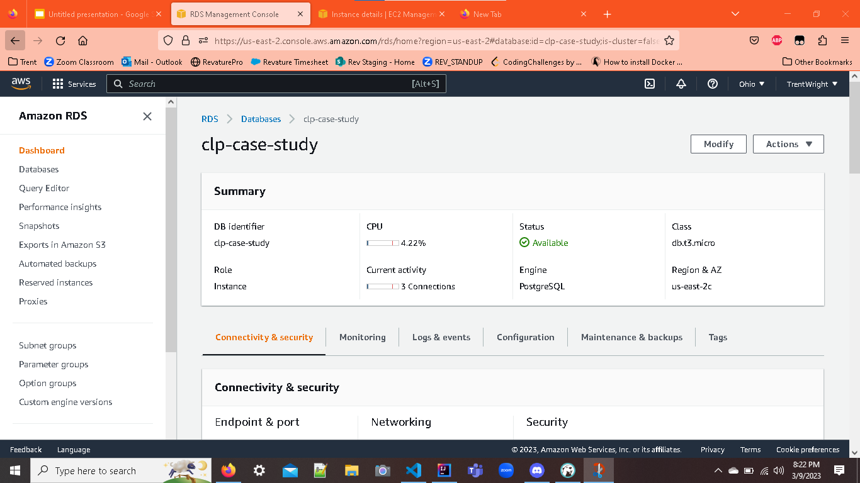
AWS
RDS

Slide 5
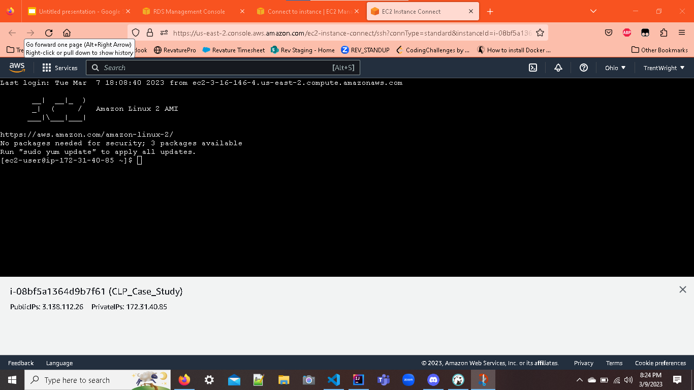
AWS
EC2

Slide 6
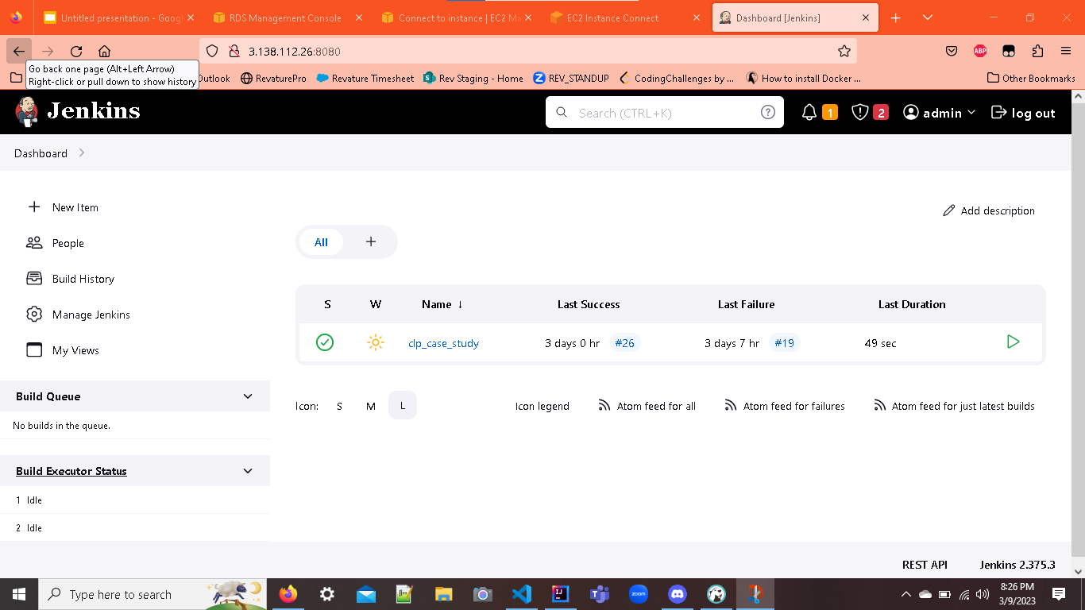
Jenkins
On
EC2

Slide 7
Start Demo:

Slide 8
Challenges Faced and Additional Features Built But Unimplemented:

Slide 9
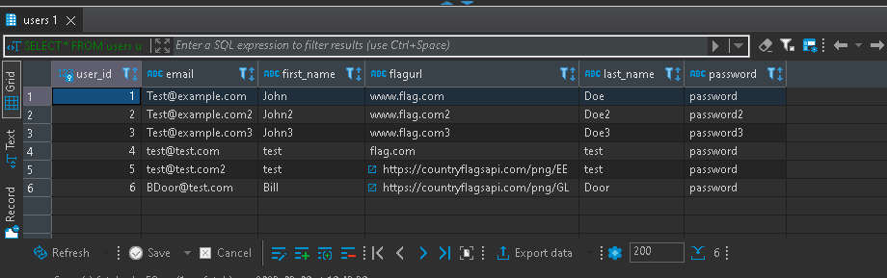
Users with FlagURLs

Slide 10
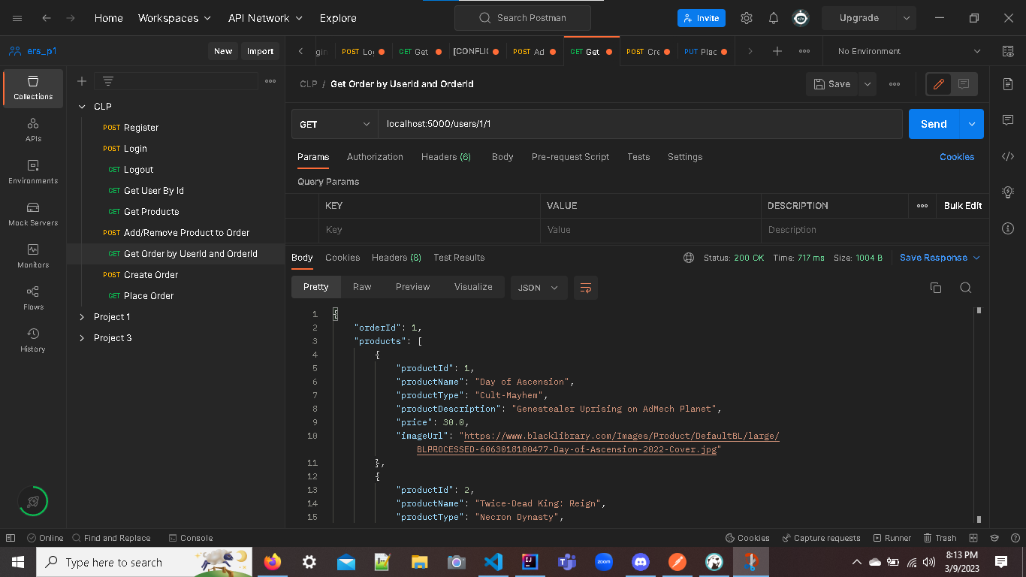
Add/Remove Product from Order
Place
Order
Get
Order
By
Id

